Slide 1
Pre-Live Session
Model Building

Slide 2
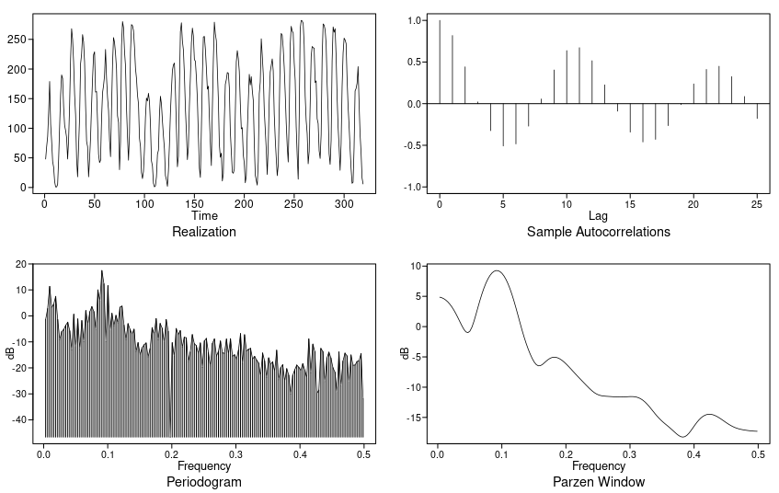
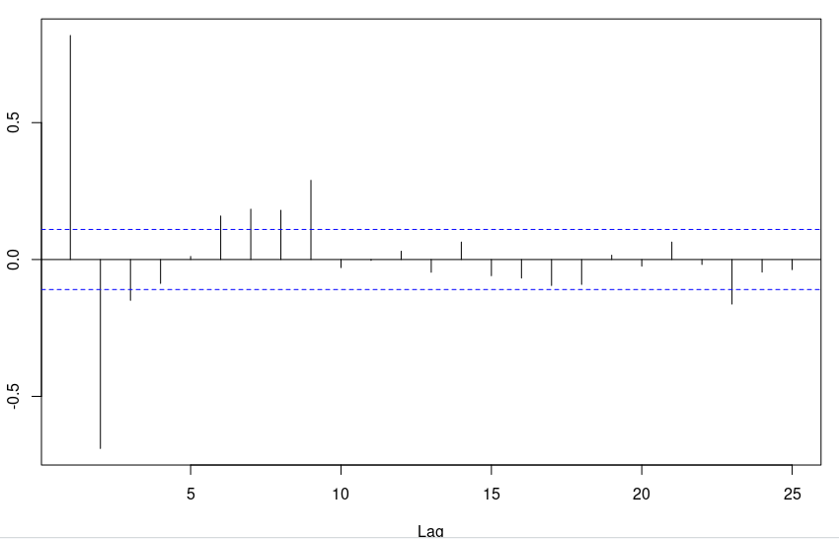
Sunspot Data
PACF
This is a non-stationary data because it’s mean and variance is dependent on time. AIC with type BIC produced AR(9). I will compare AR(9) to a seasonal model. Since I think it is seasonal with frequency/peak at 0.083 equivalent to 1/12, I expect this to be a better model. Box -Jenkins sugested a AR(2).

Slide 3
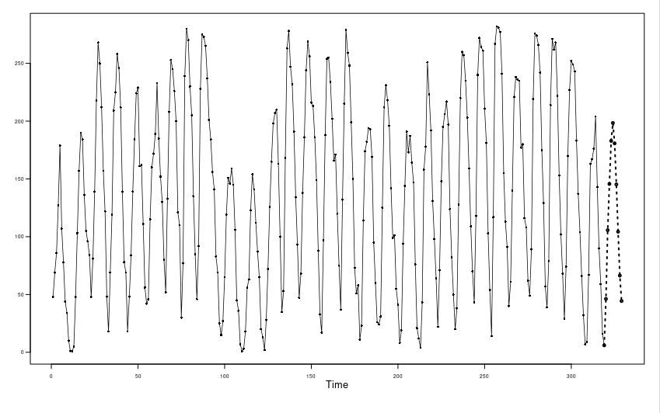
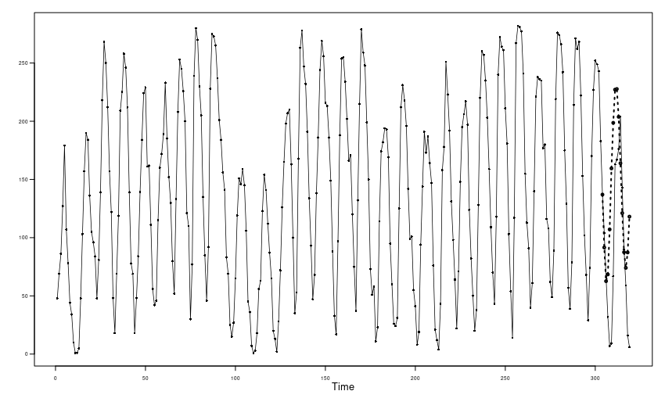
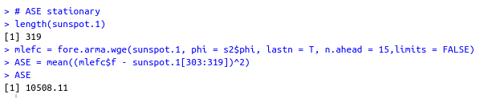
Sunspot Data stationary
The stationary AR(9) produced an ASE of 10508.11 and the forecast is represented above. The L. Junng test also showed that there is evidence that the residuals from this model is white noise.

Slide 4
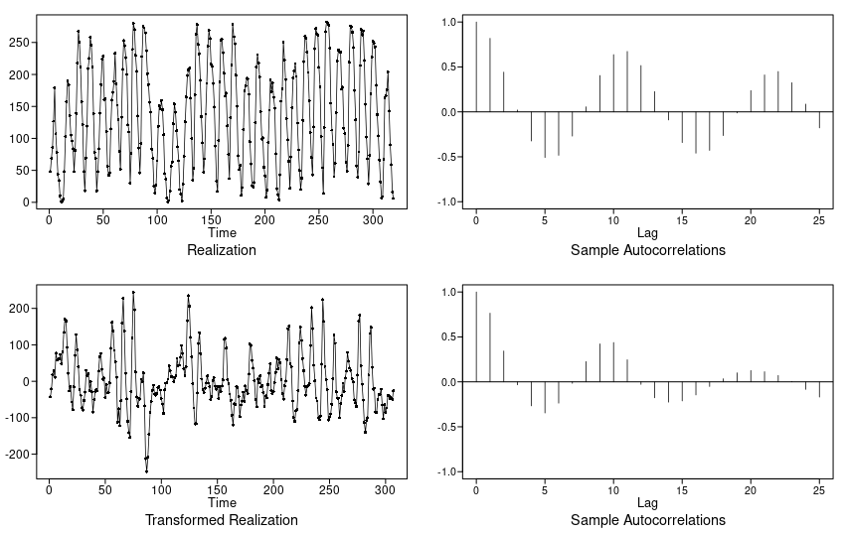
Sunspot Data non-stationary (Differenced)

Slide 5
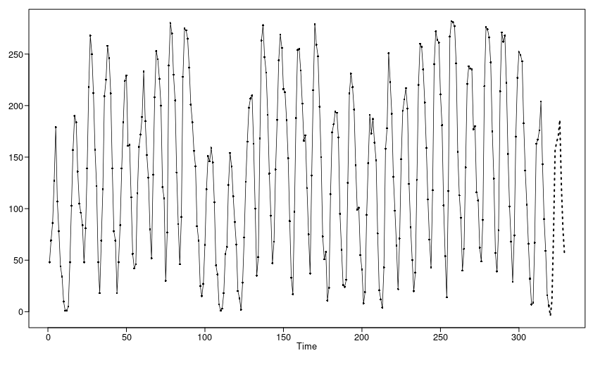
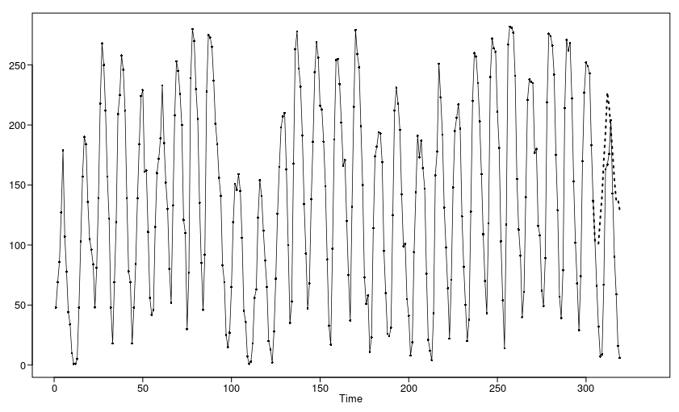
Sunspot Data non-stationary
The non-stationary s = 12 and AR(14) produced an ASE of 8199.14 and the forecast is represented above. The score suggests that this is the better model but the forecast plots suggests otherwise. The L. Junng test also showed that there is evidence that the residuals from this model is not white noise. P-val is 0.0049 for K = 24 and 0.01 for K = 48. Based on the ASE, one might choose this model but there is evidence that the residual isn’t white noise so I will choose the stationary model. The stationary model do have 1-0.95B factor.

Slide 6
Takeaways
Check for model appropriateness.
  Stationary vs non-stationary
  Seasonal vs non-seasonal
  Correlation-based vs signal-plus-noise model
  Are characteristics of fitted model consistent with those of the data
    Forecasts and spectral estimates make sense?
    Do realizations and their characteristics behave like the data?
Realizations from AR(ARMA/ARUMA) models have random trends
  Unless there are 2 unit roots, these models will not forecast a trend to continue
Realizations from signal plus noise have deterministic trends
  If conditions do not change, then these trends will be forecast to continue.
Analysts can choose model in order to produce desired results.

